Slide 1

7e A great place
Writing a description of a place
1 Read the text. Where do you think it’s from? Choose one of the options (a–c).
a a personal blog
b an estate agent’s website
c a tourist information website
b (the text uses typical estate agent words and phrases: charm; within walking distance; good schools close by; prices are reasonable)
7e-p89

Slide 2
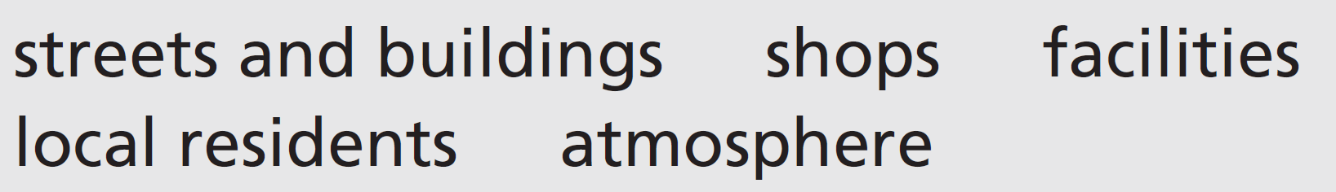
2 How does the writer describe these things?
streets and buildings: historic; streets are picturesque streets; gorgeous buildings
shops: fascinating old shops
facilities: variety of bars, restaurants, leisure centres; great parks (like Greenfields), an excellent public library and good schools
local residents: a real sense of community; a mix of original residents and new arrivals
atmosphere: a lot of charm; almost like living in a village
7e-p. 89

Slide 3
3 Writing skill organizing ideas
a Read the text again. Write the number of the paragraph (1–4) next to the heading. There is one extra heading.
a What kind of place is Sandgate?
b What are the bad points?
c Overall opinion?
d What kind of people live there?
e What can you do there?
paragraph 1
(not used)
paragraph 4
paragraph 3
paragraph 2
b Where is the best place in the text to include a paragraph with the extra heading from Exercise 3a?
The paragraph on ‘What are the bad points?’ should not be first or last. It could come as the second paragraph, but would be best as the penultimate paragraph.
7e-p. 89

Slide 4
Word focus as and like
4 Look at these two extracts from the text. Choose the correct option. Then find two more examples of as and like which have these meanings.
1 … and like many other historic city-centre neighbourhoods, it has …
It is similar to / It is many historic city-centre neighbourhoods.
2 As a person who lives in a city, I know …
I am similar to / I am a person who lives in a city.
Other examples in the text: it’s almost like living in a village; Sandgate seems to be perfect both as a place to live and a place to visit
7e-p. 89

Slide 5
5 Find two other examples of as and like in the text. Match the examples with these meanings.
1 because
2 for example
because: As there’s so much to do within walking distance
for example: there are great parks (like Greenfields)
6 Complete the sentences with as and like.
1 _____________________________ a life-long resident of my town, I take pride in our community.
2 I love modern shopping malls _____________________________ this.
3 It’s ideal _____________________________ a holiday destination.
4 Our public library is _____________________________ a palace.
5 _____________________________ all good cafés, the one in my village has a great atmosphere.
6 The old buildings _____________________________, the town hall, are beautiful.
As (having a job, role or use)
like (‘similar to’)
as (having a job, role or use)
like (‘similar to’)
Like (‘similar to’)
like (‘for example’)
7e-p. 89

Slide 6
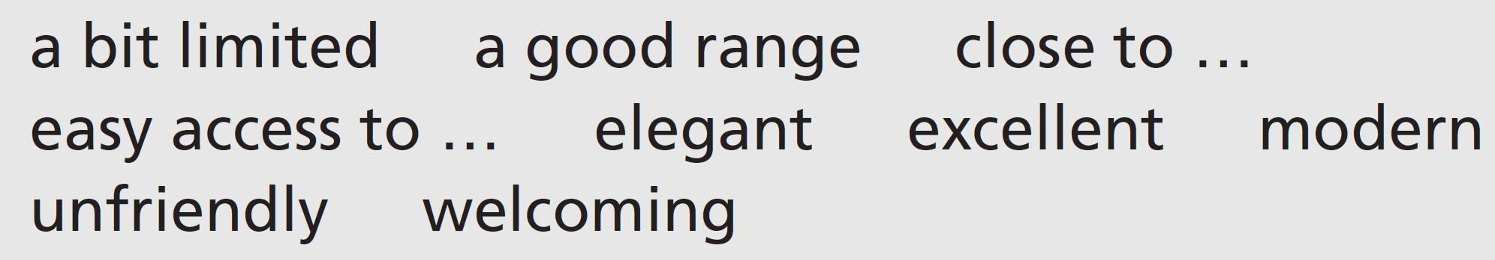
7 You are going to write a description of your own neighbourhood. Make notes using the headings in Exercise 3a. Use these words or your own ideas.
8 Decide on the order of the paragraphs in your description. Then write about 150–200 words.
9 Use these questions to check your description.
• Are your ideas clearly organized into paragraphs?
• If you’ve included as or like, have you used them correctly?
• Does your description give the reader a clear picture of your neighbourhood?
10 Read a description a classmate has written about their neighbourhood. Would you like to move there or not? Give your reasons.
7e-p. 89

Slide 7

7f The town with no wi-fi
Before you watch
1 You’re going to watch a video about a town in the USA that has no wi-fi or mobile phones. What would be the main change in your life if you didn’t have wi-fi? Would it be good or bad?
Students’ own ideas
Two satellite dishes in the USA
7f-p. 91

Slide 8
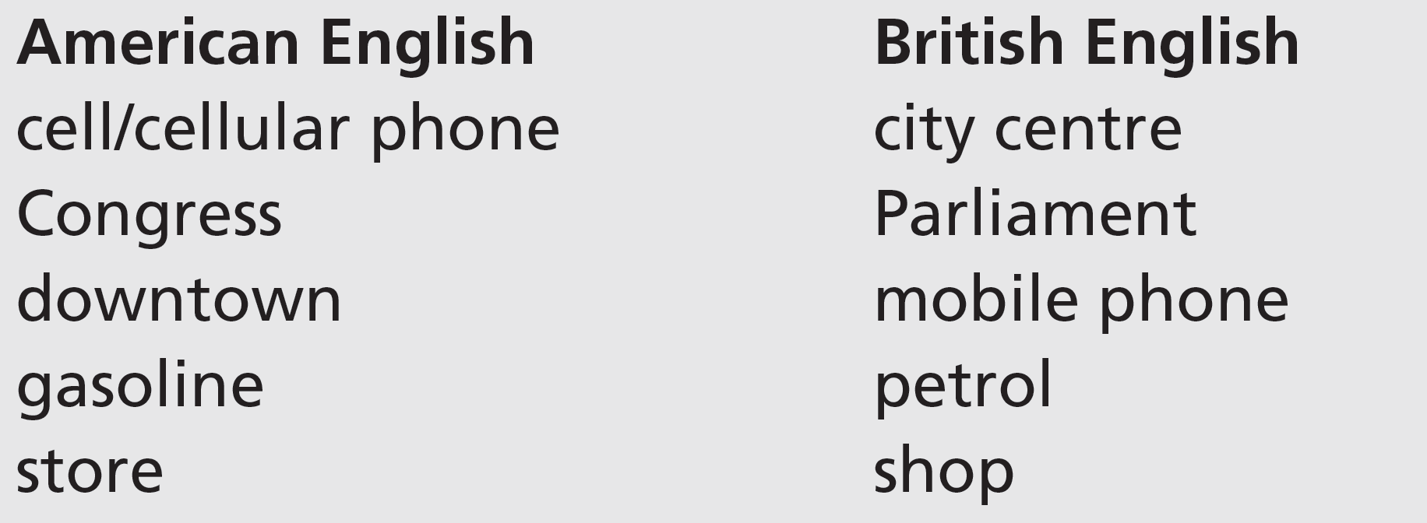
2 The speakers in the video use American English. Match the American English terms with similar British English terms.
cell/cellular phone = mobile phone
Congress = Parliament
downtown = city centre
gasoline = petrol
store = shop
7f-p. 91

Slide 9
3 Key vocabulary
a Read the sentences. The words in bold are used in the video. Guess the meaning of the words.
1 Jack built his house to his own design – it’s certainly unique!
2 I’d love to have a telescope to see the stars at night.
3 I can’t call you from the beach because there’s no phone signal.
4 The heavy traffic badly affects the city’s atmosphere.
5 I’ve looked all over the house for the cordless phone, but I can’t find it.
b Match the words in bold in Exercise 3a with these definitions.
2
3
1
4
5
a a piece of equipment that makes distant things seem closer
b radio waves which are sent or received
c special and different from any others
d the air in a certain place or area
e without a cable or wire attached to it
7f-p. 91

Slide 10


While you watch
4 Watch the video. Complete the sentences with the names of the people you see.
1 ____________________ and ____________________ are residents of the quiet zone (QZ) in Green Bank, West Virginia.
2 ____________________ works as the Business Manager of the National Radio Astronomy Observatory (NRAO) in Green Bank.
3 ____________________ is the Site Director of the National Radio Astronomy Observatory (NRAO) in Green Bank.
Artie Barkley
Joyce Nelson
Michael Holstine
Karen O’Neil
7f-p. 91

Slide 11
5 Work in pairs. Discuss the questions.
1 What does quiet zone mean exactly?
2 What does the NRAO do in Green Bank?
1 Quiet Zone (QZ) means no cell phones, etc.
2 NRAO uses a radio telescope in Green Bank for listening for signals from space.
6 Watch the first part of the video (0.00–0.59) again. Check your ideas from Exercise 4. What do the people say?
1 Artie Barkley says he just listens to ____________.
2 Michael Holstine says that to ____________ the radio atmosphere, Congress created the National Radio Quiet zone.
3 Karen O’Neil says if you have a radio ____________ in an area of lots of radio noise, the signal you’re looking for is destroyed.
nature
protect
telescope
7f-p. 91

Slide 12
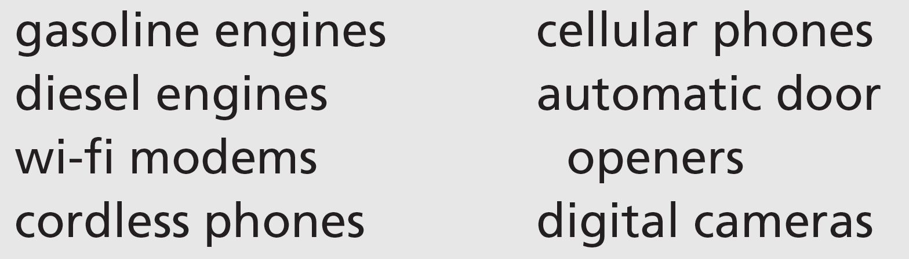
7 Watch the second part of the video (1.00 to the end) again. Answer the questions.
1 Which ONE of these modern conveniences is it OK to use in Green Bank?
2 Why would it be difficult to create a new radio quiet zone?
1 diesel engines
2 because you’d have to walk into an area and take things away from people
7f-p. 91

Slide 13
Videoscript
The town with no wi-fi
Part 1
0.00–0.24 Artie Barkley, Quiet Zone Resident
What I like best about living in the quiet zone, and it kind of tells the whole story, the quietness. Some people come here and say, ‘What do you do?’, well I just say I’m doing it right now, you know. And I say ‘Just listen to nature all around you’.
0.28–0.40 Michael Holstine, Business Manager NRAO
Green Bank, West Virginia is a very unique place. I find it ironic sometimes that we are working with technology here that’s world class, it’s world leading, but yet no-one here has a cell phone.
0.45–1.02 Karen O’Neil, Site Director NRAO
So a radio telescope works just like an optical telescope, in that if you build it or have it in an area where there’s a lot of radio noise, the signals that you are trying to look for would be obliterated by that radio noise in the same way you can’t see the Milky Way in downtown New York City.

Slide 14
Videoscript
The town with no wi-fi
Part 2
1.03–1.39 Michael Holstine
A cell phone on Mars would be the brightest radio object to us in the sky. In order to protect the radio atmosphere in this area, Congress created the National Radio Quiet Zone, and that’s an area that’s 13,000 square miles. There’s actually a long list of modern conveniences that we can’t utilize here, and that generally shouldn’t be utilized in the community. Gasoline engines cause a problem, we only use diesels on site. Wi-fi modems, cordless telephones, no cellular phones, the automatic door opener at the local store, no digital cameras.
1.40–1.52 Joyce Nelson, Quiet Zone Resident
I really enjoy it because it’s quiet, it’s peaceful, it’s beautiful. All these electronic technician things that these kids are sitting pushing buttons on, don’t happen here. Only way you can do that is at home.
1.55–2.13 Karen O’Neil
It would be very difficult to create a radio quiet zone these days, because in order to create it you would have to walk into an area and take things away from people. But living here, people have grown up without it, and they have built their homes and they built everything around the idea that they will be wired, they won’t have wireless systems.

Slide 15

After you watch
8 Vocabulary in context
a Watch the clips from the video. Choose the correct meaning of the words and phrases.
b Answer the questions in your own words. Then work in pairs and compare your answers.
1 How many world-class sportspeople can you name?
2 Have you ever met anyone who is just like someone you know?
3 What’s life like in your community?
Students’ own answers
7f-p. 91

Slide 16
Videoscript
The town with no wi-fi
c
b
b
a
c
1 What I like best about living in the quiet zone, and it kind of tells the whole story ...
a is a type that
b generously
c more or less
2 ... we are working with technology here that’s world class ...
a among the best in the world
b found around the world
c the only example in the world
3 … a radio telescope works just like an optical telescope …
a better than
b in the same way as
c together with
4 … and that generally shouldn’t be utilized in the community.
a by people who live here
b inside the NRAO base
c in the shops
5 ... they’ve built everything around the idea that they will be wired ...
a be continually connected
b be monitored by the NRAO base
c only use technology connected by cables

Slide 17
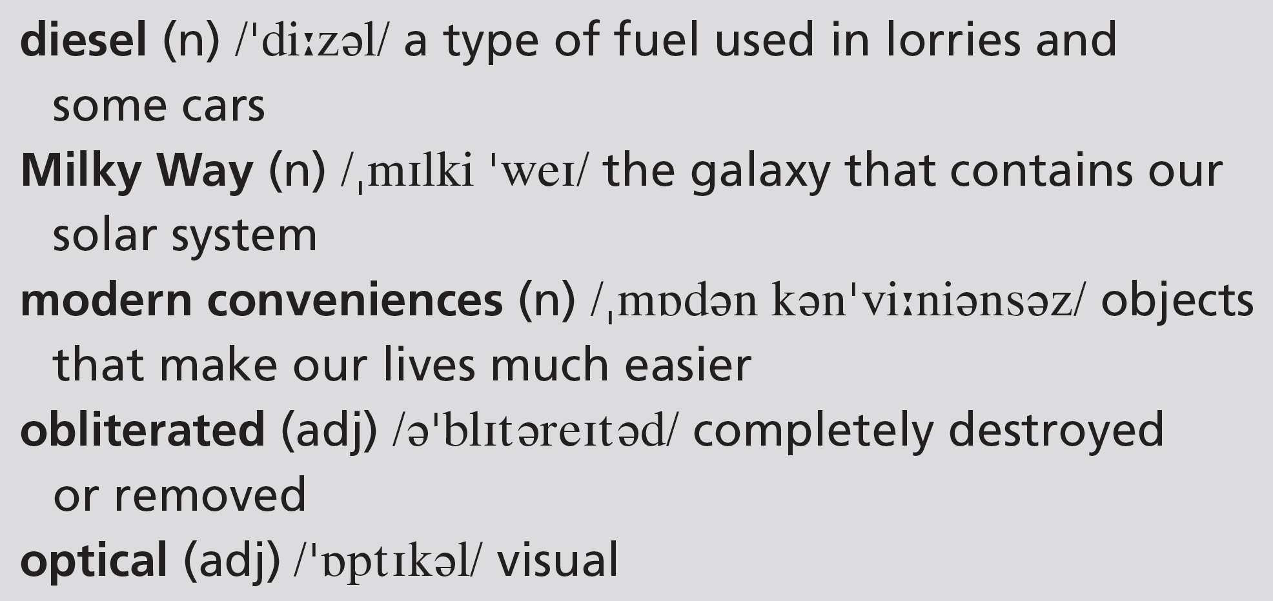
9 Work in pairs. Discuss the questions.
1 Do the residents of Green Bank seem happy to live there? Give your reasons.
2 How would you feel about living in a quiet zone like Green Bank?
EXAMPLE ANSWERS
1 The residents of Green Bank all seem happy. They praise the peace and quiet or say how amazing it is to work in a high technology place without using new technology themselves.
2 Students’ own answers
7f-p. 91

Slide 18
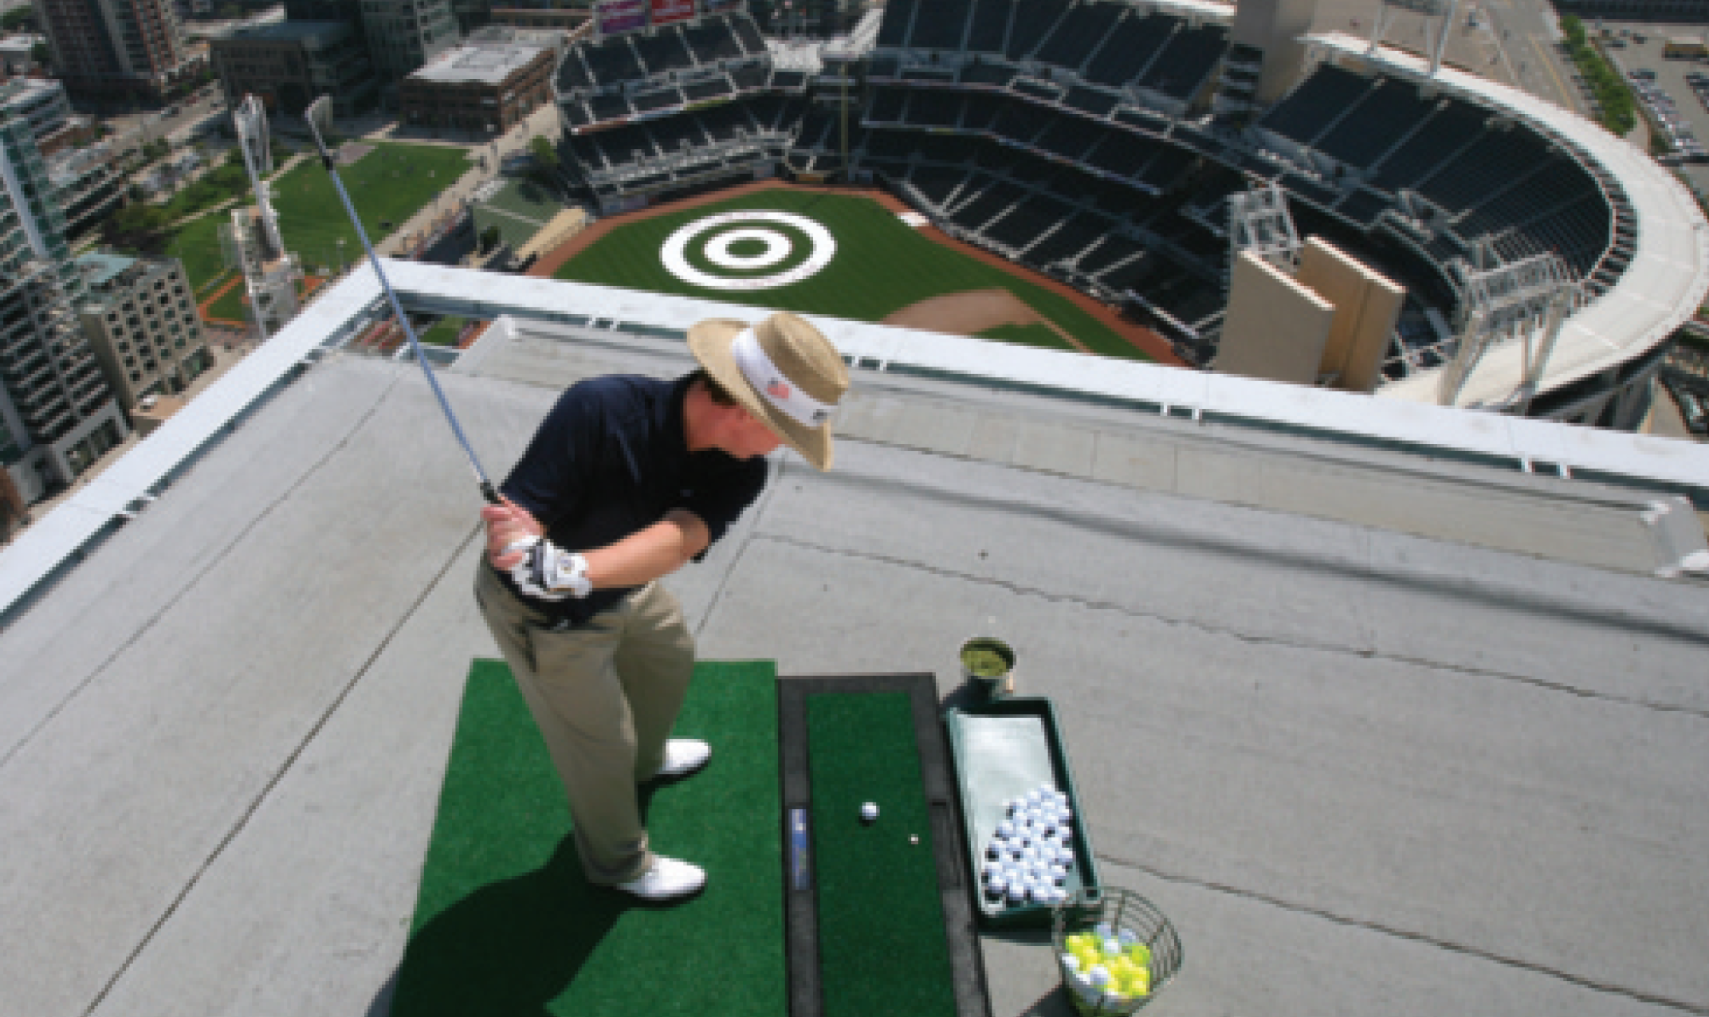
UNIT 7 REVIEW AND MEMORY BOOSTER
Grammar
1 Look at the photo of rooftop golf. Then complete the text. Use comparative forms and patterns of adjectives and adverbs. Use the past simple and used to form of the verbs.
U7 Review-p. 92

Slide 19
I’ve never heard of rooftop golf before. I suppose that as cities get 1 _________________ (big / big), people live a long way from golf courses. When I was a kid I 2 _________________ (live) in a block of flats with a basement car park. During the day, the car park 3 _________________ (be) almost empty, so we 4 _________________ (play) football there. Obviously, we played 5 _________________ (well) on a real field and we couldn’t kick the ball 6 _________________ (as / hard / as) when we played outside, but we 7 _________________ (not mind). Having the basement meant we could play 8 _________________ (often). These days in cities, gyms seem to be 9 _______________________ (more / more / popular).
I suppose people spend a lot of time sitting at desks or in cars. And 10 _________________ (less / active) they are, 11 _________________ (healthy) they feel. Gyms have taken the place of open spaces in a lot of cities.
bigger and bigger
used to live
was
used to play
better
as hard as
didn’t mind
more often
more and more popular
the less active
the less healthy
U7 Review-p. 92

Slide 20
2 Answer the questions about the text in Exercise 1.
1 What are the advantages and disadvantages of playing football in the car park?
2 Why are gyms popular in cities?
1 Advantages: they could play more often, it’s convenient Disadvantages: they couldn’t play as well there as on a field and they couldn’t kick the ball as hard as when they played outside.
2 People spend a lot of time sitting at desks or in cars and this means they are less active and feel less healthy.
U7 Review-p. 92

Slide 21
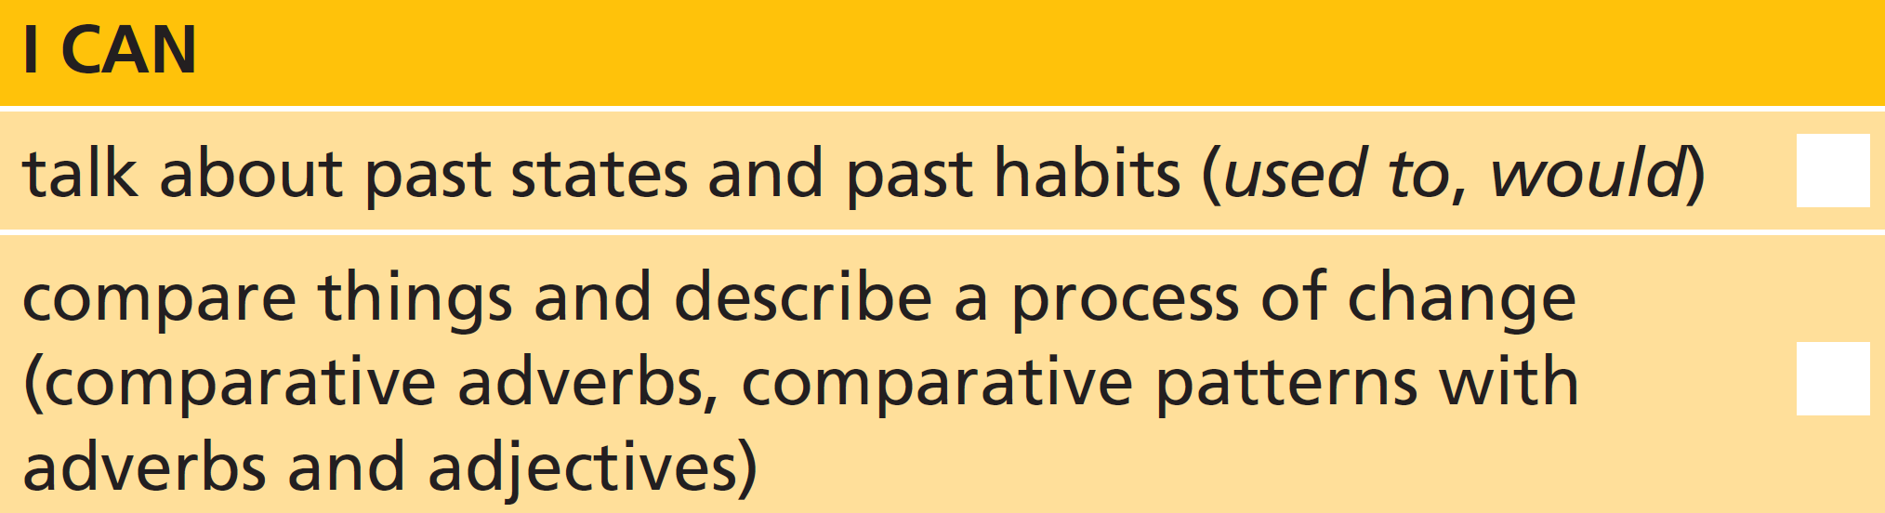
3 Write comments about the photo with a comparative form or pattern of the adverb or adjective. Then compare your sentences with your partner.
1 hit the ball / on a normal golf course (carefully)
2 get / to the edge (close)
3 practise / want to (often)
4 play / up there (well)
5 reach the target / each day (accurately)
6 hit the ball / go (harder / further)
1 You have to hit the ball more carefully than on a normal golf course.
2 You get closer and closer to the edge.
3 You can practise as often as you want to.
4 You can play better up there. / You can’t play as well up there.
5 Each day you reach the target more accurately.
6 The harder you hit the ball, the further it goes / will go.
U7 Review-p. 92

Slide 22
Vocabulary
4 Which is the odd one out in each group? Why?
1 bricks, igloo, wood
2 run-down, skyscrapers, traffic
3 flat, house, neighbourhood
4 built-up, polluted, residents
5 garden, town, village
1 igloo (the others are things that homes are made from)
2 run-down (the others are things you find in cities)
3 neighbourhood (the others are types of home)
4 residents (the others are adjectives which describe cities)
5 garden (the others are places where there are lots of homes)
U7 Review-p. 92

Slide 23

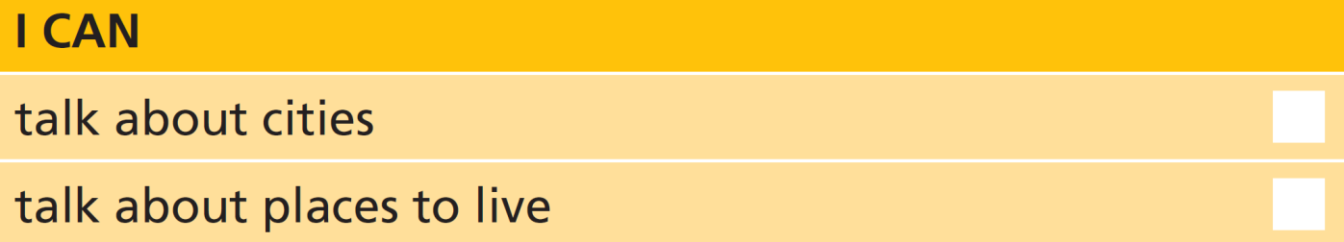
5 You are an estate agent with an important house to sell – your own. Make notes on your home and the area that it’s in. Decide on a price. Then try to sell your home to one of your classmates.
U7 Review-p. 92

Slide 24
Real life
6 Choose the correct option. Then match the two parts of the exchanges.
b
e
c
f
a
d
1 A: I’d rather / I prefer to live on my own.
2 A: Where would you rather go / to go?
3 A: I’d rather / I prefer the country to the coast.
4 A: I prefer living / live near my family.
5 A: I’d rather / I prefer visit a few more places first.
6 A: I’d rather / I’d prefer a bigger kitchen.
a B: What’s wrong with this flat?
b B: Are you looking for a flat-share?
c B: I can show you a fantastic beach house.
d B: This flat is nice. Are you going to take it?
e B: I don’t fancy looking around the city centre.
f B: Are you going to live near your work?
U7 Review-p. 92

Slide 25
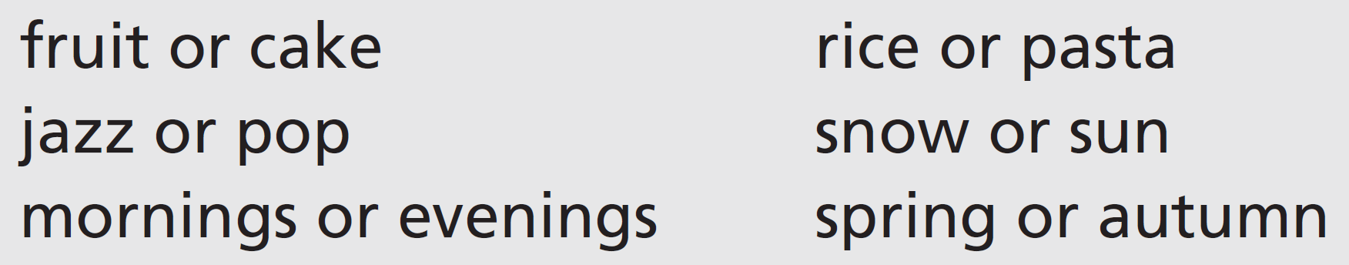
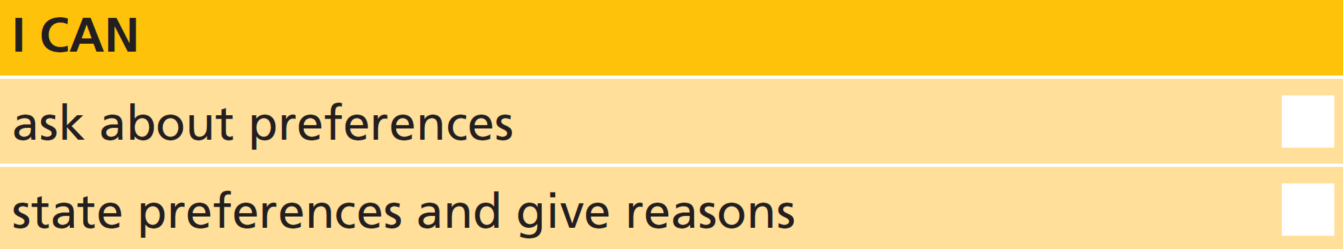
7 Work in groups. Ask and answer questions about your preferences. Give reasons for your answers.
U7 Review-p. 92

